Slide 1

NBA
SHOT LOGS
CMPS451 - Big Data Project - Team 19
13/5/2024

Slide 2
TABLE OF CONTENTS
01
02
BUSINESS PART
TECHNICAL PART

Slide 3
BUSINESS
01

Slide 4
INTRODUCTION
The NBA shot logs dataset contains detailed information about every shot taken in NBA games over a specific period.
This data is very useful for looking at how individual players and teams perform and plan their games.
In today's competitive sports world, using big data analytics is important because it helps teams make better decisions, win more games, and be more successful. By studying this dataset, teams and coaches can find trends and patterns that help them make smarter choices and stay ahead in the game.

Slide 5
DATASET OVERVIEW
The NBA shot logs dataset provides detailed records of every shot taken during NBA games. It includes information like player names, shot distances, and whether the shot was a 2-point or 3-point attempt.
Additional details such as the game clock, shot clock, and the distance of the closest defender are also provided.
This rich dataset enables analysis, helping to spot important trends and patterns that inform smart decision-making. Understanding how these variables interact and relate to each other is crucial for extracting meaningful insights from the data.

Slide 6
MARKET ANALYSIS
Delivers crucial performance insights to team managers, coaches, scouts, and analysts, enhancing decision-making across player selection and strategic planning.
Supports the sports industry's shift towards analytics by providing actionable insights, which are increasingly demanded for competitive and tactical advantage.
Facilitates informed decisions regarding player performance and roster management, significantly improving team strategies and on-court success.

Slide 7
COMPETITIVE BENEFITS
Detailed analytics enable tailored training and development, enhancing individual and team performance levels.
Leverages data to identify opponent weaknesses and adapt strategies in real-time, giving teams a tactical edge during games.
Data-driven insights assist in optimal player selection and lineup configurations, maximizing team potential and efficiency.

Slide 8

CASE STUDY
An example of a team which utilized dataset is Golden State Warriors.
One of the first teams to use data for choosing shots and setting up player positions.
Used data to shoot more three-pointers before other teams, helping make this strategy popular in the NBA.
Won several NBA championships and broke season records, showing how well their approach worked.

Slide 9
DATASET LIMITATIONS
Sometimes the data is not perfect or complete.
The data might have some biases or errors.
These issues can make the insights less accurate or trustworthy.
The NBA changes often, so it’s crucial to keep updating the data to keep it useful.
It’s important to keep working on improving the data analysis to make sure it stays useful and relevant.

Slide 10
CONCLUSION
To conclude, the NBA shot logs dataset provides useful info for teams and stakeholders, helping them make better decisions and find new ways to succeed.
By understanding the dataset, identifying trends and patterns, and addressing challenges and limitations, you can help your audience appreciate the immense business value that can be derived from big data analytics in the sports industry.
Encourage your audience to consider the potential benefits of leveraging data analysis to make more informed decisions and improve their team's performance.

Slide 11
TECHNICAL
02

Slide 12
DATASET PREPROCESSING
FILLING NULL DATA
REPLACING NEGATIVE DATA
WE FILLED THE NULL DATA WITH THE PREVIOUS VALUE USING FORWARD FILL TECHNIQUE
WE REPLACED THE NULL DATA WITH THE MEAN VALUE.
DATA CONVERSION
DROP UNNECESSARY COLUMNS
WE CONVERTED THE “GAME CLOCK” into seconds for model training and map-reduce functions
WE DROPPED COLUMNS THAT DIDN’T CORRELATE WITH THE OTHER DATA.

Slide 13
OUTLIERS
We could not simply remove the outliers as they are so meaningful for us in calculating for the map-reduce functions , also it didn't affect the model training accuracy.

Slide 14
DATA VISUALIZATION

Slide 15
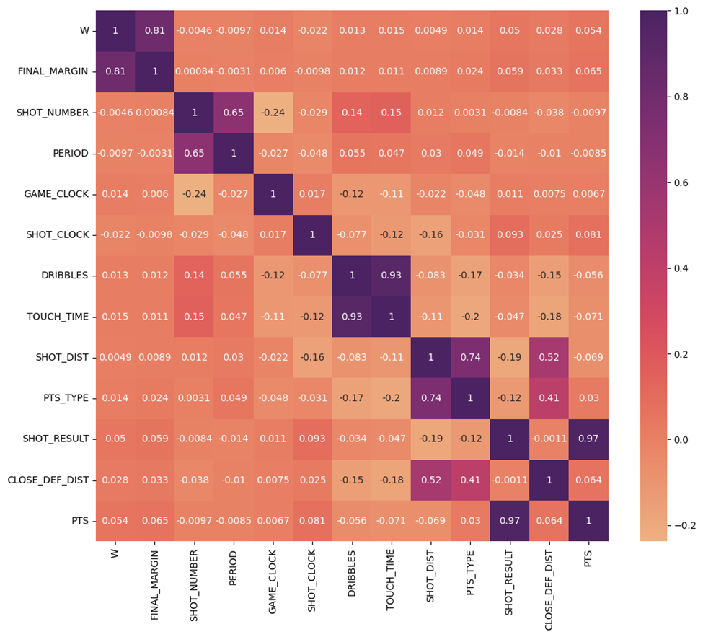
CORRELATION HEAT MAP

Slide 16
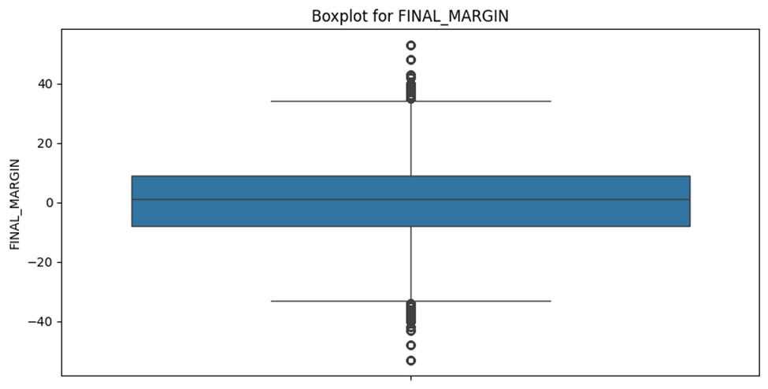
EXAMPLE FOR A BOX PLOT FOR OUTLIERS DETECTION

Slide 17
MODELS
Classifier Training and Comparing

Slide 18
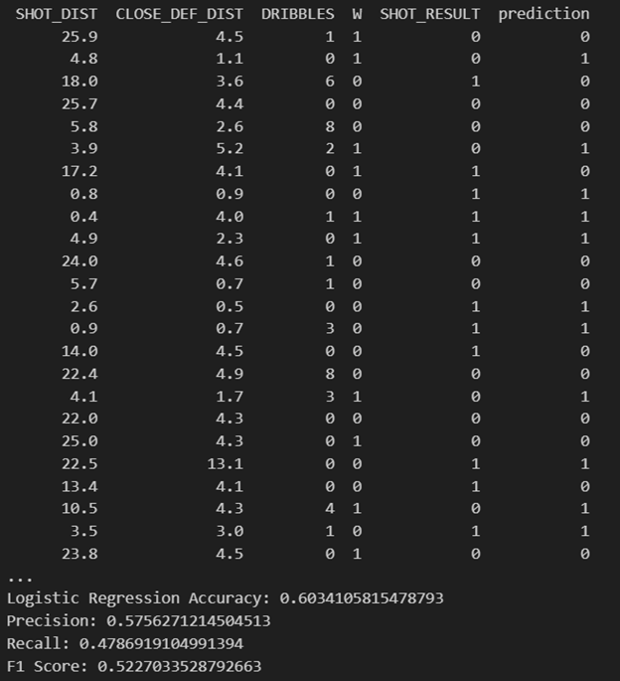
LOGISTIC REGRESSION

Slide 19
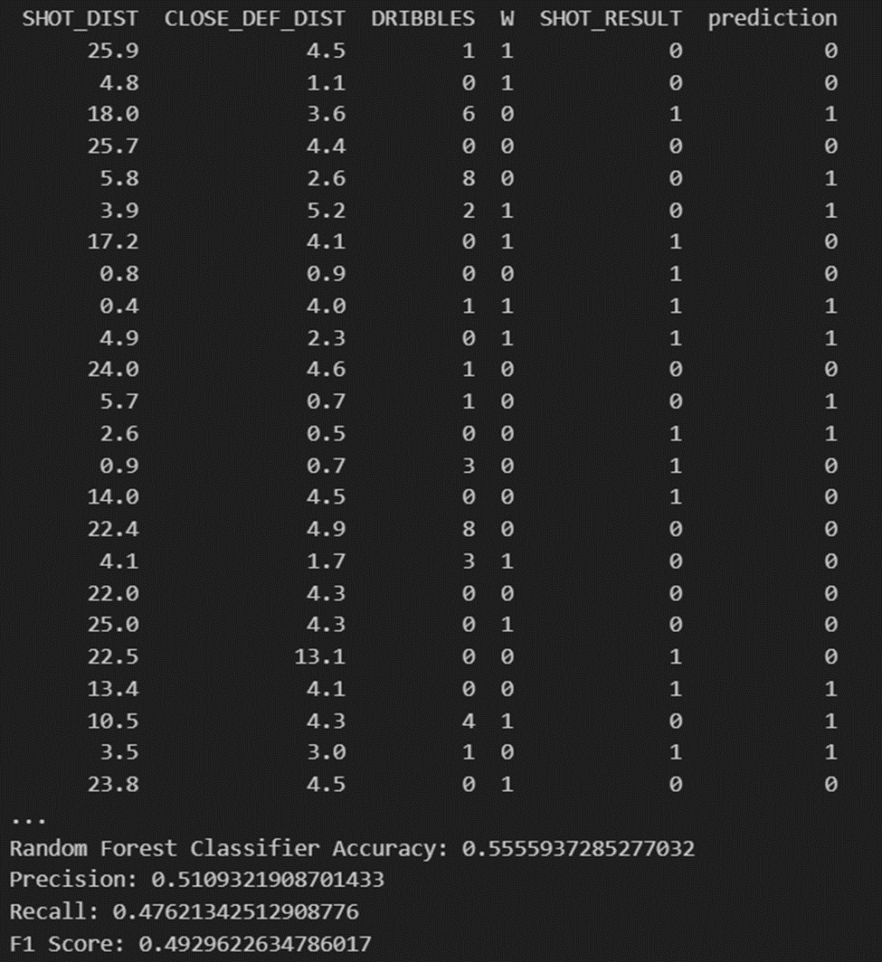
RANDOM FOREST

Slide 20

KNN

Slide 21

GRADIENT BOOSTING

Slide 22
MAP REDUCE
Map-Reduce functions using libraries and from scratch

Slide 23
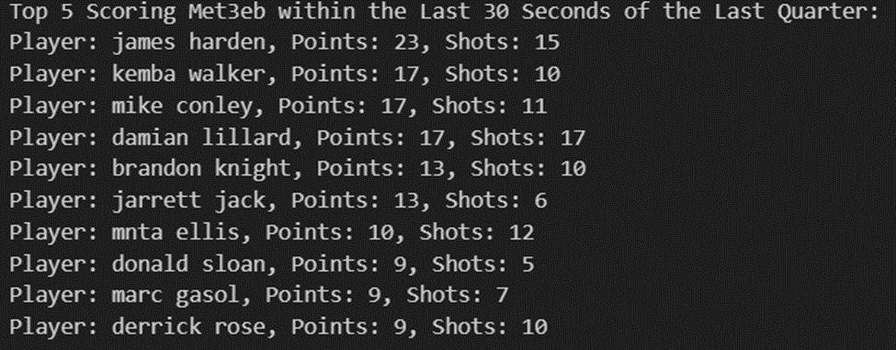
The most scoring players in the last 30 seconds of the last quarter. ( From Scratch )

Slide 24
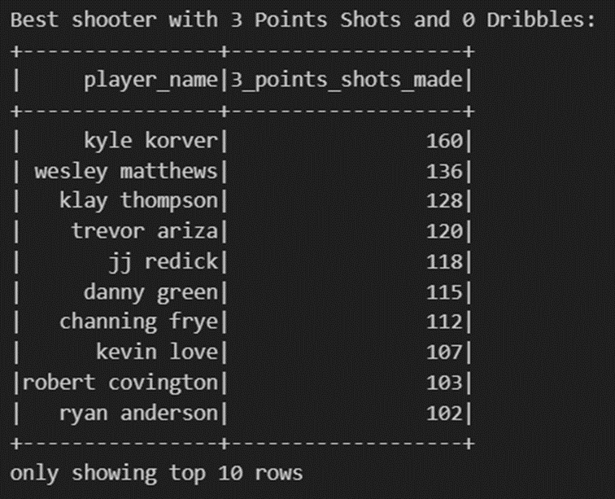
Top shot players who scored 3 points with 0 dribbles ( Using PySPARK)

Slide 25
THANKS
ANY QUESTIONS?

